Slide 1


DARK WEB MONITORING
TEAM - DECODE SHARK

Slide 2
MEMBERS OF THE TEAM
ABINASH NANDA
SWOPNA SARIT BARIK
• RESOURCE
• OSINT
• LOGIC BUILDING
• DEVELOPMENT
• AUTOMATION
• SCRIPTING
RAHUL MOHAPATRA
• RESEARCH
• DEPLOYMENT

Slide 3

WHAT IS DARKWEB ?
The Dark Web is a collection of websites, forums, and marketplaces that are only accessible by using the Tor browser. This specialized browser grants users a level of anonymity that is especially appealing to cybercriminals, hackers, and government operatives who want to hide their identity.

Slide 4
P.S-2 : Solution for Dark Web monitoring, offering an easy-to-use interface, secure browsing, advanced data filtering, and effective tracking mechanisms. Features :
It detects onion links which deals with illegal activities in the dark web.
This tool provides strong security, which maintains the Anonymity.
Finds onion links available in the dark web based on particular keyword.
Browsing through TOR Relay Network, which can’t expose our real IP.

Slide 5
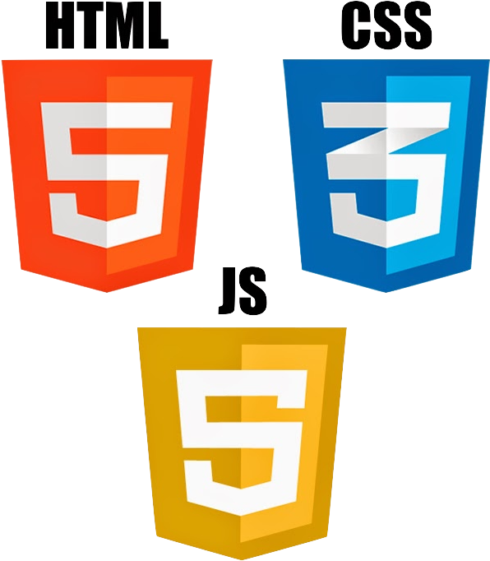


TECHNOLOGIES USED
HTML CSS JavaScript Python BASH SCRIPTING

Slide 6
UNIQUENESS OF THIS TOOL

Slide 7
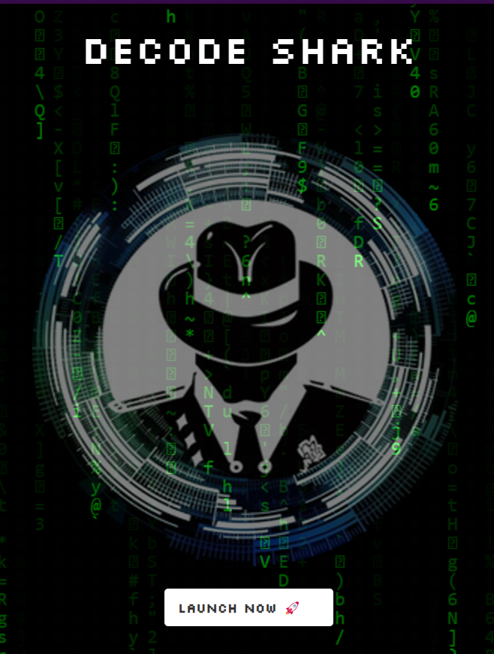
I. Automated Setup
As our solution of this problem statement, It’s only need to run a single bash script command on any Linux operating system to configure the tool.

Slide 8
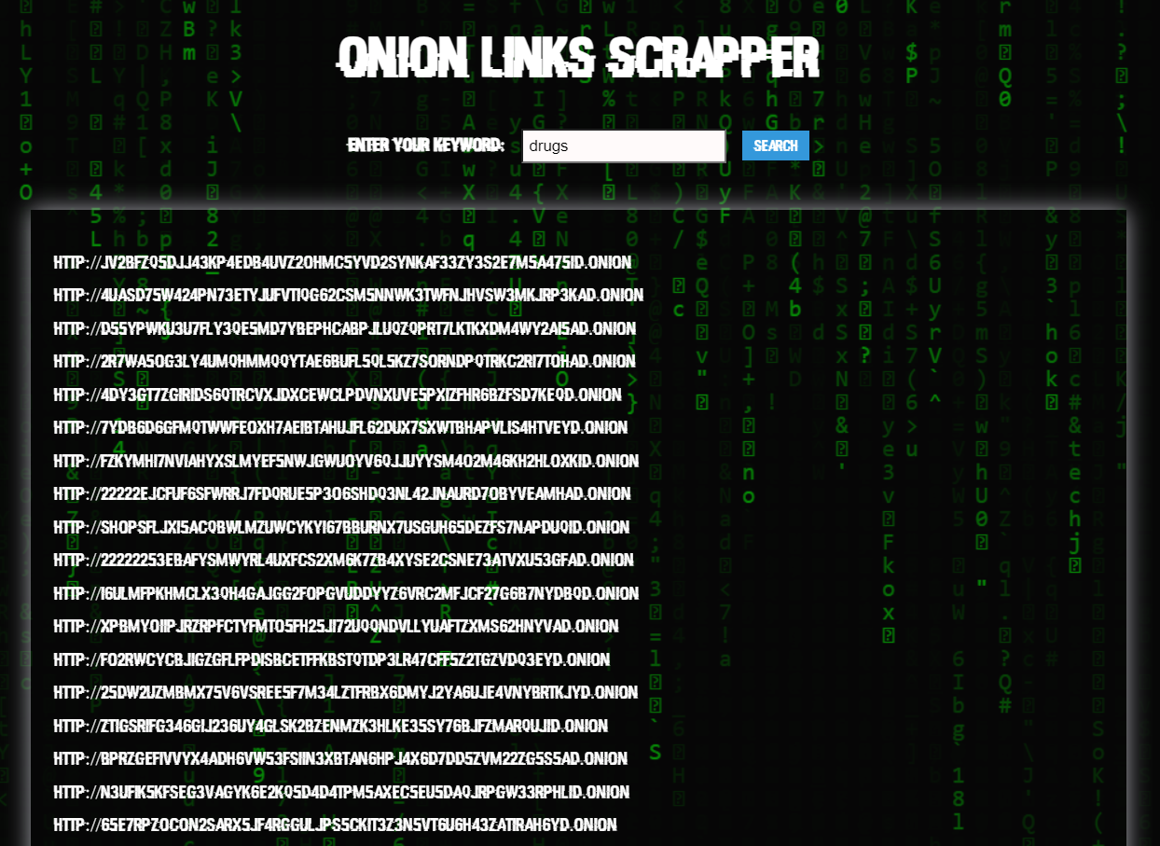
II. Onion Links Scrapper
The scrapper takes the
Keyword input from user
& lists all the onion
Sites available in
Dark web.
Also it stores the outputs as CSV.

Slide 9
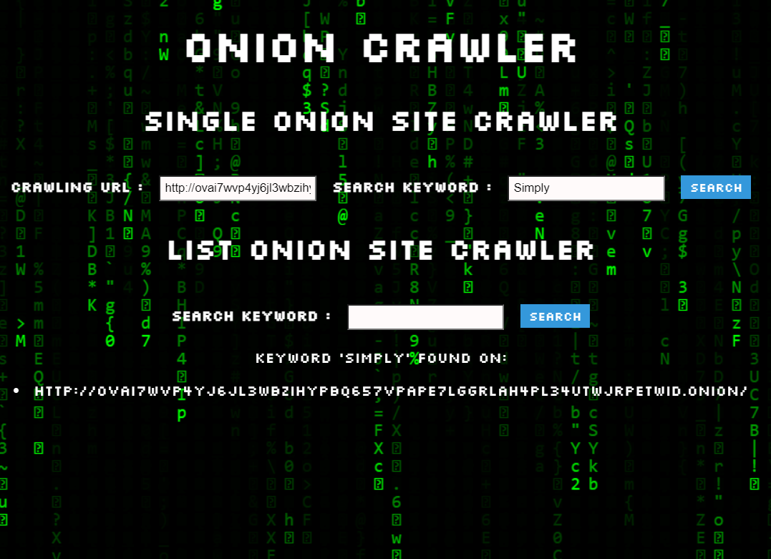
III. Dark Web Crawler
The crawler takes the
URL along with the specific keyword from the user & shows whether the site contains that specific keyword or not without manually visiting that website.
Also it stores the outputs as CSV.

Slide 10
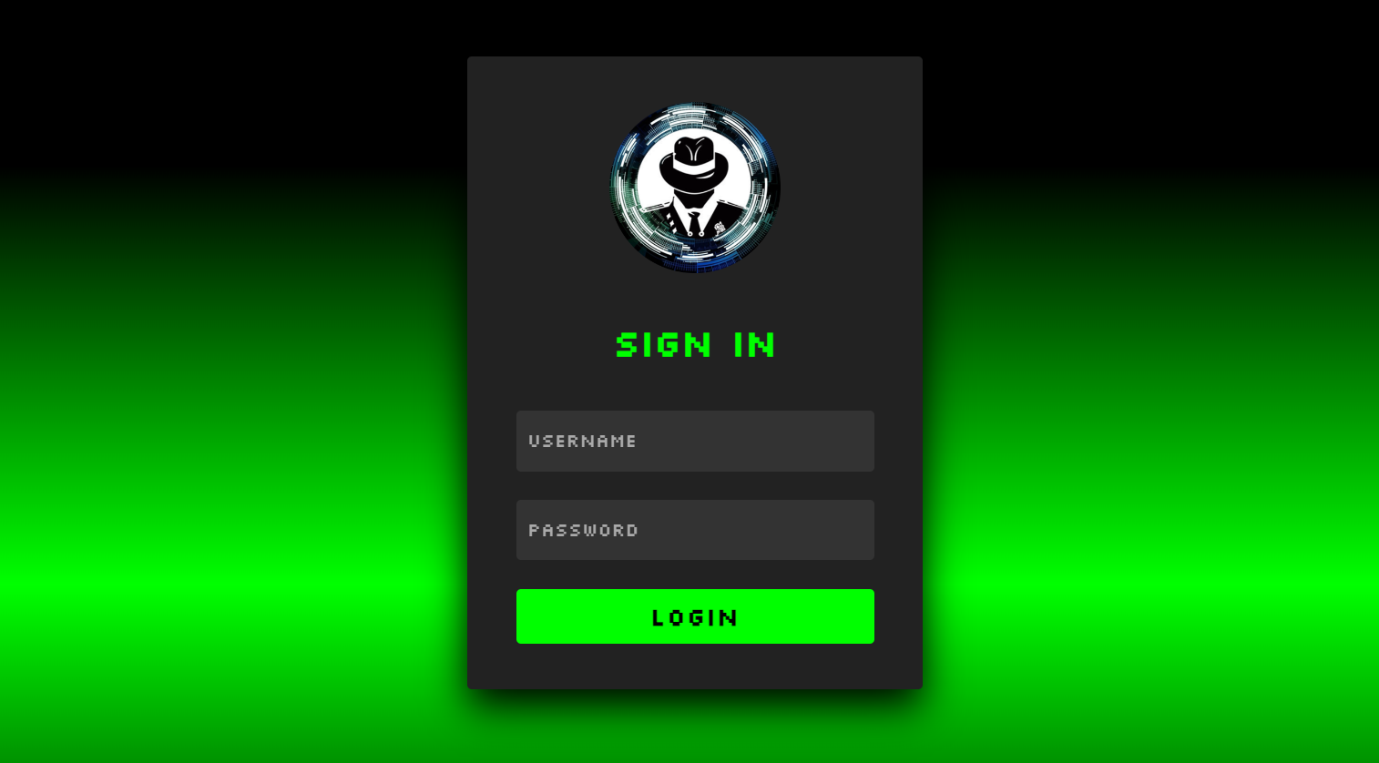
IV. User Friendly GUI
The friendly GUI feature lets everyone use the tool without having any difficulty. It makes the interface easy and convenient to use.

Slide 11
FUTURE SCOPE OF OUR PROJECT
Normal user can check whether their data is leaked in the dark web or not.
Image & Email Scrapping
The tool will provide a way to view web archives. This can be useful in tracking the past of a website or a user

Slide 12
THANK YOU!

